Slide 1
Processor control Instructions of 8086

Slide 2
Processor Control Instructions
Flag Operations
No Operation
External synchronization
STC
CLC
CMC
STD
CLD
STI
CLI
NOP
HLT
WAIT
ESC
LOCK

Slide 3
Flag Operations
STC – Set Carry Flag
Example:
STC
This instruction is used to set the carry flag.
1
Mnemonic: STC
U
U
U
U
OF
DF
IF
TF
SF
ZF
U
AF
U
PF
U
CF
Operation :
CF = 1
Addressing Mode : Implied addressing mode
Flags : Except carry flag no other flags are affected.

Slide 4
CLC – Clear Carry Flag
Example:
CLC
This instruction is used to clear the carry flag.
0
Mnemonic: CLC
U
U
U
U
OF
DF
IF
TF
SF
ZF
U
AF
U
PF
U
CF
Operation :
CF = 0
Addressing Mode : Implied addressing mode
Flags : Except carry flag no other flags are affected.

Slide 5
Example:
CMC – Complement Carry Flag
CMC
This instruction is used to complement the carry flag.
0
1
U
U
U
U
OF
DF
IF
TF
SF
ZF
U
AF
U
PF
U
CF
Mnemonic: CMC
1
0
Operation :
CF = CF
If CF = 0 then after execution of CMC instruction CF = 1
If CF = 1 then after execution of CMC instruction CF = 0
Addressing Mode : Implied addressing mode
Flags : Except carry flag no other flags are affected.

Slide 6
STD – Set Direction Flag
This instruction is used to set the direction flag.
DF flag is used in string instruction.
If DF= 1 then in case of string instructions SI and DI automatically decremented.
Example:
STD
Mnemonic: STD
1
U
U
U
U
OF
DF
IF
TF
SF
ZF
U
AF
U
PF
U
CF
Operation :
DF = 1
Addressing Mode : Implied addressing mode
Flags : Except Direction flag no other flags are affected.

Slide 7
CTD – Clear Direction Flag
This instruction is used to clear the direction flag.
DF flag is used in string instruction.
If DF= 0 then in case of string instructions SI and DI automatically incremented.
Example:
CTD
Mnemonic: CTD
0
U
U
U
U
OF
DF
IF
TF
SF
ZF
U
AF
U
PF
U
CF
Operation :
DF = 0
Addressing Mode : Implied addressing mode
Flags : Except Direction flag no other flags are affected.

Slide 8
STI – Set Interrupt Enable Flag
This instruction sets the interrupt flag to 1.
This enables INTR interrupt of the 8086.
Example:
STI
Mnemonic: STI
1
U
U
U
U
OF
DF
IF
TF
SF
ZF
U
AF
U
PF
U
CF
Operation :
IF = 1
Addressing Mode : Implied addressing mode
Flags : Except Interrupt flag no other flags are affected.

Slide 9
CLI – Clear Interrupt Enable Flag
This instruction resets the interrupt flag to zero.
If the interrupt flag is reset, the 8086 will not respond to an interrupt signal on its INTR input.
Example:
STI
Mnemonic: CTI
0
U
U
U
U
OF
DF
IF
TF
SF
ZF
U
AF
U
PF
U
CF
Operation :
IF = 0
Addressing Mode : Implied addressing mode
Flags : Except Interrupt flag no other flags are affected.

Slide 10
No Operations
NOP – No Operation
Example: NOP
The execution of this instruction causes the CPU to do nothing.
This instruction uses three clock cycles and increments the instruction pointer to point to the next instruction.
It can be used to increase the delay of delay loop.
Mnemonic: NOP
Operation :
Do nothing
Addressing Mode : Implied addressing mode
Flags : Dose not affect any flag.

Slide 11
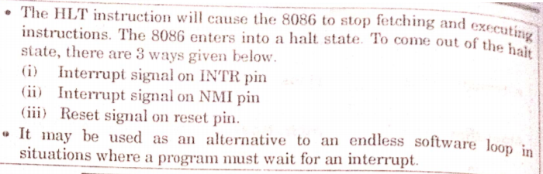
External synchronization
HALT – Halt until interrupt or reset
Mnemonic: HLT
Addressing Mode : Implied addressing mode
Flags : Dose not affect any flag.

Slide 12
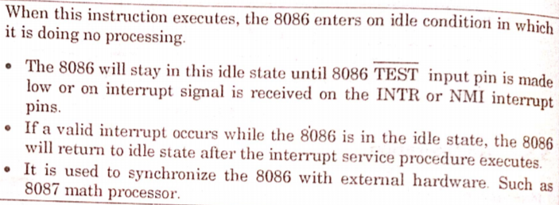
WAIT – Wait for test pin active
Mnemonic: WAIT
Addressing Mode : Implied addressing mode
Flags : Dose not affect any flag.

Slide 13
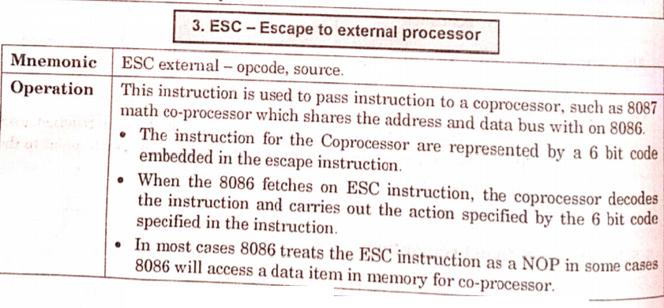

Slide 14
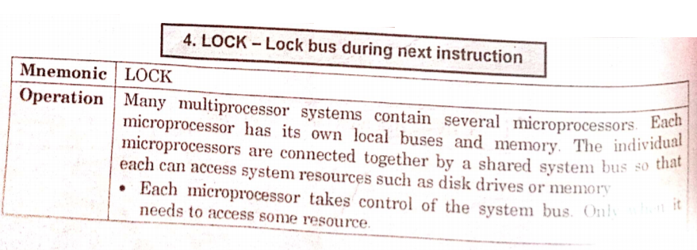
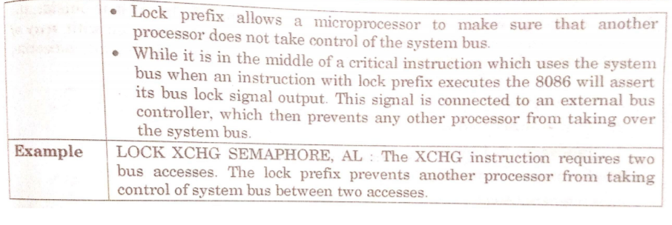
when

